Slide 1
CS 4504 Parallel and Distributed Computation Distributed Storage
Kun Suo
Computer Science, Kennesaw State University
https://kevinsuo.github.io/

Slide 2
Outline
Distributed Storage
Hashing
Consistent hashing
Consistent Hashing with Bounded Loads
Consistent Hashing with Virtual Nodes

Slide 3
Why Distributed Storage?
With the increase of data volume and user access, single-machine performance can no longer meet requirements
Distributed storage has become a common method to provide large-scale applications with large-capacity, high-performance, highly available, and highly scalable storage services.

Slide 4
Distributed Storage
Key idea:
Write: store the data on different machines according to certain rules.
Read: looking for certain machines according to certain rules and get the stored data.
Applications
Hash, range, …
Rules
Data a
Data b
Data c
Data d

Slide 5
Distributed Storage in Daily Life

Slide 6
Distributed Storage in Daily Life
Customer
--> Product tags/boards
--> Product Shelf
Application
--> Rules, e.g., index
--> Data storage node

Slide 7
1. Application: Read/Write Data
Application:
Producer: generate original data
Consumer: use and update the data
Data:
Structured data, semi-structured data, unstructured data
e.g., seller release new products
e.g., consumer buy new products, comments, …
Applications (Producer)
Data platform
Applications (Consumer)

Slide 8
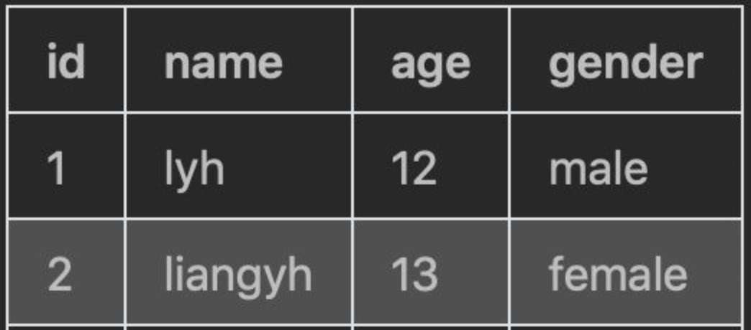
1. Application: Read/Write Data
Structured data refers to any data that resides in a fixed field within a record or file. This includes data contained in relational databases and spreadsheets.

Slide 9

1. Application: Read/Write Data
Semi-structured data is a form of structured data that does not obey the formal structure of data models associated with relational databases or other forms of data tables, but nonetheless contains tags or other markers to separate semantic elements and enforce hierarchies of records and fields within the data.

Slide 10
1. Application: Read/Write Data
Unstructured data is information that either does not have a pre-defined data model or is not organized in a pre-defined manner.

Slide 11
2. Rules/index: get the location of data
Data sharding refers to a distributed storage system that stores data in the corresponding storage node or obtains the desired data in the corresponding storage node according to certain rules.
Benefits:
Reduce storage and access pressure on a single storage node
Quickly find the storage node where the data resides, thereby greatly reducing search latency

Slide 12
2. Rules/index: get the location of data
Data sharding example
Users
Only need to search node A, reduce the search operations on all nodes
Amazon
Website
Data sharding based on data characteristics
Node A
Node B
Node C
Node D
Shoes
Computers
Clothes
Food

Slide 13
2. Rules/index: get the location of data
Suppose you have hundreds of gigabytes data to store across multiple nodes, how to do that?
Three dimensions of design principle:
data uniformity (even distribution)
data stability
node heterogeneity

Slide 14
3. Nodes: store the data
Structured data: distributed database, stored by tables. Example: MySQL Sharding, Microsoft SQL Azure, Google Spanner.
Semi-structured data: distributed key/value store database, stored by key/values. Example: Redis, Memcache.
Unstructured data: use files/blocks/objects to store. Example: Ceph, GFS, HDFS, Swift

Slide 15


3. Nodes: store the data
Disk storage is large, but the IO overhead is significant, and the access speed is low. It is often used to store data that is not used frequently.
The memory capacity is small, but the access speed is fast. It is used to store data that needs to be accessed frequently.

Slide 16
Data uniformity of design principle
The data stored in different storage nodes should be balanced as much as possible to avoid overloading the storage pressure of one or some nodes, while other nodes have little data.
For example, 100G data, 4 nodes, it is desired that each node stores 25G data.
User access must be balanced to avoid a situation in which one or more nodes have a large number of visits while other nodes are left with few visits.
For example, 1000 requests, 4 nodes. Each node processes 250 requests.

Slide 17
Data stability of design principle
When a storage node fails and needs to be removed or augmented, the data should be kept as stable as possible, and no large-scale data migration will occur
Example, 100G data. At the beginning, there were 4 nodes of the same type (nodes 1 to 4). Each node stored 25G data. Now node 2 fails, which means that each node needs to store 100G / 3 data.

Slide 18
Node heterogeneity of design principle
The hardware configuration of different storage nodes vary widely. For example, some nodes have high hardware configurations that can store large amounts of data and can withstand more requests; however, some nodes have poor hardware configurations and cannot store too much data and users cannot access too much
A good data distribution algorithm should consider node heterogeneity

Slide 19
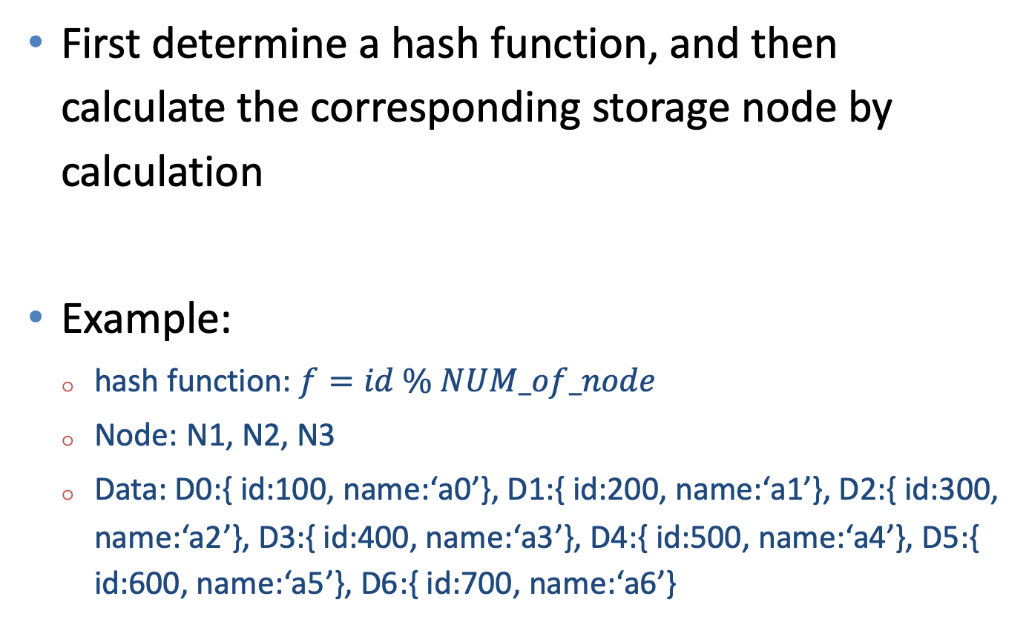
Hashing
First determine a hash function, and then calculate the corresponding storage node by calculation
Example:
hash function: $f=id \% NUM_of_node$
Node: N1, N2, N3
Data: D0:{ id:100, name:‘a0’}, D1:{ id:200, name:‘a1’}, D2:{ id:300, name:‘a2’}, D3:{ id:400, name:‘a3’}, D4:{ id:500, name:‘a4’}, D5:{ id:600, name:‘a5’}, D6:{ id:700, name:‘a6’}

Slide 20
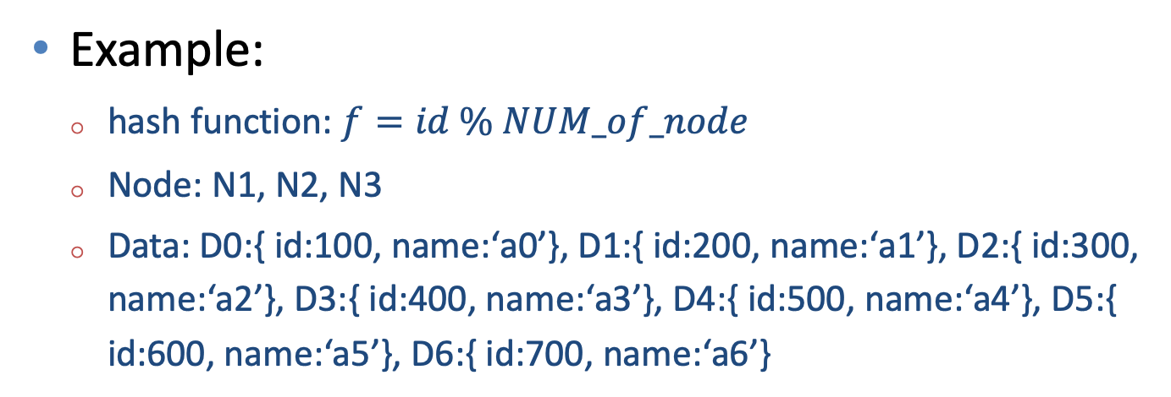
Hashing
Example:
hash function: $f=id \% NUM_of_node$
Node: N1, N2, N3
Data: D0:{ id:100, name:‘a0’}, D1:{ id:200, name:‘a1’}, D2:{ id:300, name:‘a2’}, D3:{ id:400, name:‘a3’}, D4:{ id:500, name:‘a4’}, D5:{ id:600, name:‘a5’}, D6:{ id:700, name:‘a6’}

Slide 21
Hashing
Advantages:
Guarantee data uniformity (e.g., the data will be stored across the nodes evenly)

Slide 22
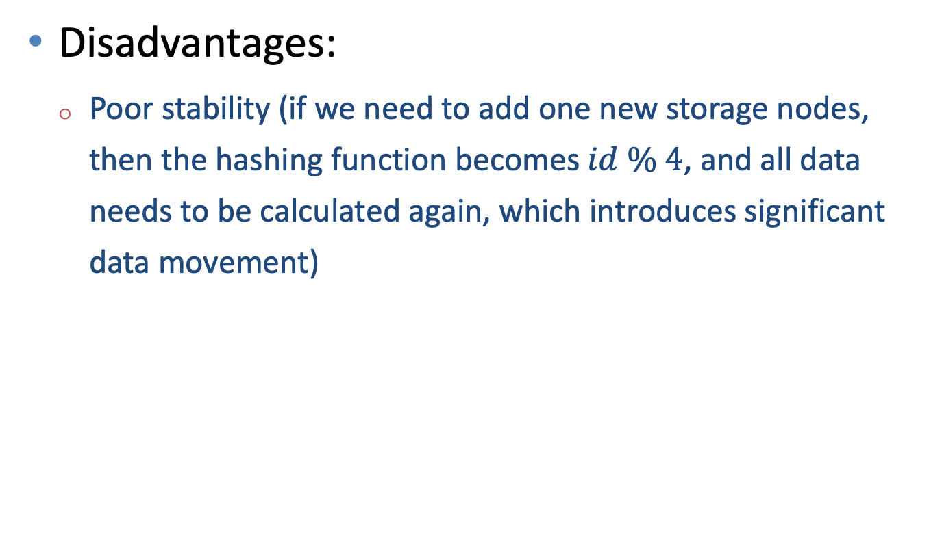
Hashing
Disadvantages:
Poor stability (if we need to add one new storage nodes, then the hashing function becomes $id \% 4$, and all data needs to be calculated again, which introduces significant data movement)
Node4?

Slide 23
Hashing
Scenario:
The hash method is suitable for scenarios where the number of nodes of the same type is relatively fixed
Example:
redis

Slide 24
Consistent hashing
Map the storage nodes and data to a hash ring. The data is looking clockwise in the ring and select the first node as its storage node.
Example:
Node: N1, N2, N3
Data: D0:{ id:100, name:‘a0’}, D1:{ id:200, name:‘a1’}, D2:{ id:300, name:‘a2’}, D3:{ id:400, name:‘a3’}, D4:{ id:500, name:‘a4’}, D5:{ id:600, name:‘a5’}, D6:{ id:700, name:‘a6’}

Slide 25
Consistent hashing
Suppose the value of nodes and data in hash ring are as follows:
Nodes or data | Value
D0 | 100
D1 | 200
D2 | 300
D3 | 400
D4 | 500
D5 | 600
D6 | 700
N1 | 400
N2 | 600
N3 | 900

Slide 26
Consistent hashing
Suppose the value of nodes and data in hash ring are as follows:
Nodes or data | Value
D0 | 100
D1 | 200
D2 | 300
D3 | 400
D4 | 500
D5 | 600
D6 | 700
N1 | 400
N2 | 600
N3 | 900

Slide 27
Consistent hashing
Node1
D0
D1
D2
D3
Node2
D4
D5
Node3
D6

Slide 28
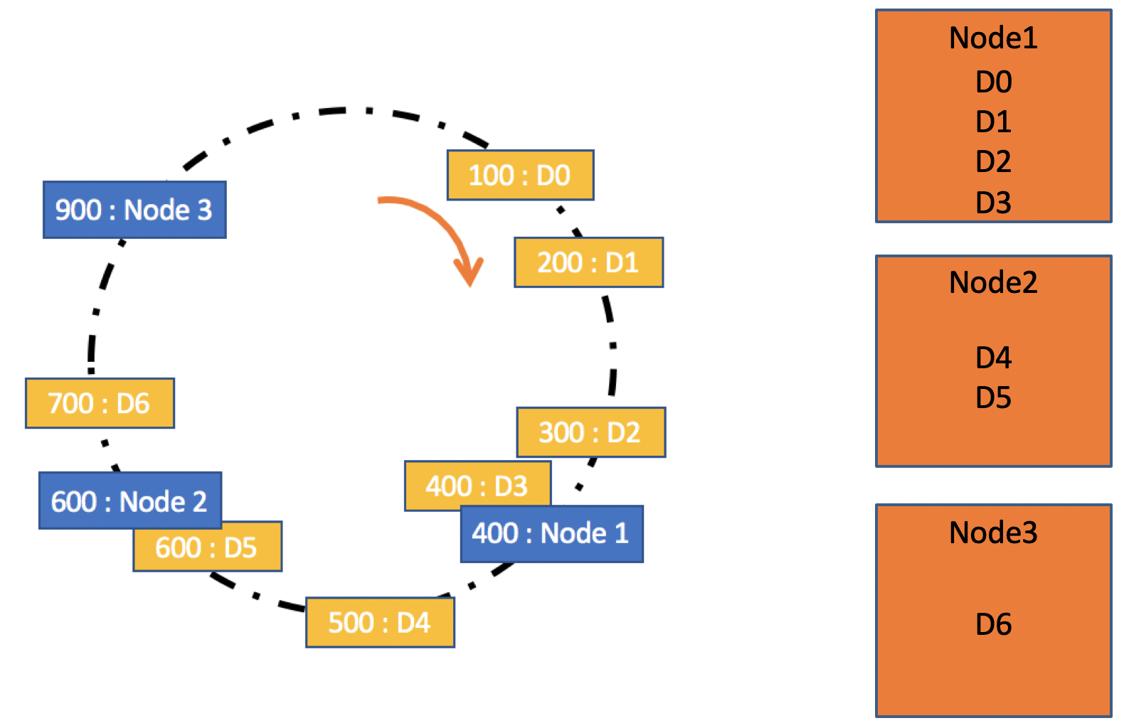
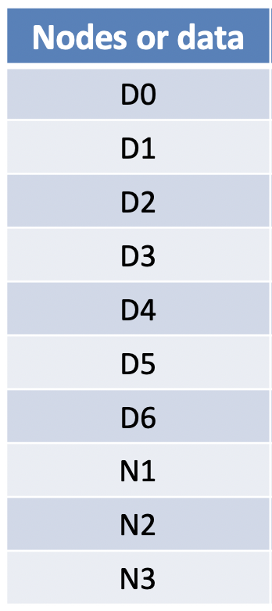
Consistent hashing
Consistent hashing is an improvement of hashing
Two layers of hashing, which improve the stability

Slide 29
Why consistent hashing has better stability?
Node1
D0
D1
D2
D3
Node2
D4
D5
Node3
D6
When node 2 fails, only D5 and D6 need to change. No large data movement.

Slide 30
Consistent hashing
Scenario:
Suitable for scenarios where nodes are the same type and node size will change
Example:
Cassandra

Slide 31
Consistent hashing
Problem:
Data uniformity. The load on subsequent nodes will become larger if the previous node fails.
More pressure on node 3
When node 2 fails, only D5 and D6 need to change. No large data movement.

Slide 32
15
0
1
2
3
12
4
8

Slide 33
Consistent Hashing with Bounded Loads
A storage upper limit value is set for each storage node to control the uneven data caused by storage node addition or removal.
When the data finds the corresponding storage node according to the consistent hash algorithm, it first determines whether the storage node has reached the storage limit; if the storage limit has been reached, it continues to search for the node after the storage node clockwise.

Slide 34
Consistent Hashing with Bounded Loads
Suppose the node load is 3
Node 1 is full and D3 has to look for the next storage

Slide 35
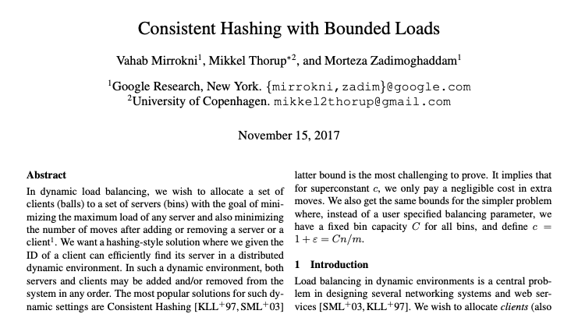
Consistent Hashing with Bounded Loads
Paper: https://epubs.siam.org/doi/pdf/10.1137/1.9781611975031.39

Slide 36
Consistent Hashing with Bounded Loads
Scenario:
Suitable for scenarios where nodes are the same type and node size will change
Example:
Google cloud, Vimeo

Slide 37

Heterogeneous Nodes
Homogeneous nodes
Hash
Consistent Hashing
Consistent Hashing with Bounded Loads
Heterogeneous Nodes?

Slide 38
Consistent hashing with virtual nodes
According to the performance of each node, a different number of virtual nodes are divided for each node, and these virtual nodes are mapped into a hash ring, and then data mapping and storage are performed according to a consistent hash algorithm
Example:
Node: N1, N2, N3. (N3 = 3*N1, N2 = 2* N1)
Data: D0:{ id:100, name:‘a0’}, D1:{ id:200, name:‘a1’}, D2:{ id:300, name:‘a2’}, D3:{ id:400, name:‘a3’}, D4:{ id:500, name:‘a4’}, D5:{ id:600, name:‘a5’}, D6:{ id:700, name:‘a6’}

Slide 39
Consistent hashing with virtual nodes
Example:
Node: N1, N2, N3. (N3 = 3*N1, N2 = 2* N1)
Data: D0:{ id:100, name:‘a0’}, D1:{ id:200, name:‘a1’}, D2:{ id:300, name:‘a2’}, D3:{ id:400, name:‘a3’}, D4:{ id:500, name:‘a4’}, D5:{ id:600, name:‘a5’}, D6:{ id:700, name:‘a6’}
Node2-1
Node1
Node2-2
Node2
virtual nodes
Node3-1
Node3
Node3-2
Node3-3

Slide 40
Consistent hashing with virtual nodes
Suppose the value of nodes and data in hash ring are as follows:
Nodes or data | Value
D0 | 100
D1 | 200
D2 | 300
D3 | 400
D4 | 500
D5 | 600
D6 | 700
Nodes or data | Value
Node1-1 | 100
Node2-1 | 200
Node2-2 | 300
Node3-1 | 400
Node3-2 | 500
Node3-3 | 600

Slide 41
Consistent hashing with virtual nodes
Nodes or data | Value
D0 | 100
D1 | 200
D2 | 300
D3 | 400
D4 | 500
D5 | 600
D6 | 700
Nodes or data | Value
Node1-1 | 100
Node2-1 | 200
Node2-2 | 300
Node3-1 | 400
Node3-2 | 500
Node3-3 | 600

Slide 42
Consistent hashing with virtual nodes
Node1
D0, D6
Node2
D1, D2
Node3
D3, D4, D5

Slide 43
Consistent hashing with virtual nodes
Scenario:
Suitable for scenarios where nodes are the different type and node size will change
Example:
Memcached

Slide 44
Comparison
 | data uniformity | data stability | node heterogeneity | Application
Hashing | Even distributed | Not stable | Same type | Redis cluster
Consistent hashing | Even distributed, but some nodes might have heavy load | Stable | Same type | Cassandra cluster
Consistent Hashing with Bounded Loads | Even distributed with load limits | Stable | Same type | Google cloud
Consistent hashing with virtual nodes | Even distributed | Stable | Different type | Memcached cluster

